Slide 1
Property Tax Rebates & Recoveries PTR & Homestead Benefit
(Federal 1040 Line 21, State Tax Refund Worksheet, &/or Schedule A Line 6)
NJ 1040 Lines 38 or 49
TaxPrep4Free.org Website - NJ Special Handling Document
Notes:
1

Slide 2
NJ Property Tax Relief Programs
Property Tax Deduction/Credit
Homestead Benefit Program
Property Tax Reimbursement (PTR)
aka Senior Freeze
Other
Deduction for Senior Citizens/Disabled
Deduction for Veterans
Exemption for Disabled Veterans

Slide 3
NJ Property Tax Deduction/Credit
(cont’d)
For: Homeowners, Tenants & Mobile Home Owners
Covered in previous module
NJ taxable income deduction or tax credit, whichever is most beneficial (TaxSlayer calculates)
Based on real estate tax or rent/mobile home site fees paid
Property Tax Deduction shown on NJ 1040 Line 38; Credit shown on NJ 1040 Line 49
Eligibility:
Age 65 & older OR blind OR disabled
Any Age with Gross Income > $20K MFJ (or $10K single or MFS)

Slide 4
NJ Property Tax Deduction/Credit
(cont’d)
To claim Property Tax Deduction/Credit:
For clients that file a NJ Tax Return:
Enter in State section \ Edit \ Enter Myself \ Credits \ Property Tax Credit/Deduction
For clients who do not file a NJ Tax Return:
Homeowner – get credit as part of Homestead Benefit
Tenant and Homeowners who are not eligible for Homestead Benefit - Manually complete NJ 1040-H to claim credit

Slide 5
Homestead Benefit Program - Eligibility
Owned & occupied their principal residence in NJ on Oct 1
Home subject to property taxes & taxes paid
Not eligible if exempt from property tax (disabled veteran/spouse) or pay Payments in Lieu of Taxes (P.I.L.O.T.)
NJ Gross Income (NJ 1040 Line 28) must be:
</= $150k for age 65 and over and/or disabled as of 12/31 (not including non-taxable income)
</= $75k for others (not including non-taxable income)
5

Slide 6
Homestead Benefit Program Info
(cont’d)
Apply for benefits each year
Homestead Benefit application now mailed to homeowners in October, 2 years after taxes paid
Apply via phone or web
Deadline: originally November, but frequently extended
Now usually receive credit on property tax bill 3 years after taxes paid. (If NJ budget does not allow, credit may not be paid or pushed back even further)
Credit for 2013 Homestead Benefit paid in May 2016 (3 years after taxes paid)
Credit for 2014 Homestead Benefit paid in May 2017
6

Slide 7
Homestead Benefit Program Info
(cont’d)
Tenants
No tenant rebates since 2009
Homeowners
Most people receive Homestead Benefit as a credit applied to their property tax bill. May receive check if:
Lived in a co-op or continuing care facility
No longer owned home
Amount calculated by the state based on property taxes paid in 2006
7
Notes:
If homeowner is planning to sell home before application due date, should answer NO to question asking whether you still own the property when filing application
If homeowner sells home after application filed but before credit received, the credit stays with the property. Must handle at closing for sale of home

Slide 8
Property Tax Reimbursement (PTR) - Eligibility
Age 65 or older, or receiving Federal SS Disability Benefits *
Must meet this requirement for two years before first applying. Therefore, must be 66, if applying based on age
Lived in NJ for at least last 10 years continuously as homeowner or tenant *
Owned (leased if mobile home) & lived in home for at least last three years *
Must have paid the full amount of property taxes that were due
Must meet total income limits for appropriate year(s)
* For married couples, only one spouse has to meet age/disability
& residency requirements

Slide 9
PTR Overview
PTR-1 filed first year
Has info for (Current year-2) AND (Current year-1)
Establish “Base Year” amount (Current year–2)
Calculate amount of reimbursement (Current year–1 amount minus Base Year (Current year-2) amount)
PTR-2 filed subsequent years
Has info for (Current year-1) only
Not available online – must use copy mailed to Taxpayer by state with pre-printed info (Name, Base Year amount)
Calculate amount of rebate (Current year-1 amount minus Base Year amount)
Note: If PTR-2 shows not eligible in any subsequent year, must wait 2 years and start over - i.e. - file PTR-1 to establish new (higher) base year
9
Notes:
The application books are Blue, so taxpayers sometimes think of application as “Blue Book”
Applications usually mailed in mid to late February and must be completed by June; deadline frequently extended

Slide 10
PTR Overview
(cont’d)
If taxpayer did not apply for PTR when first eligible or missed a year, then taxpayer can file an application for a prior year
Although PTR checks will not be issued for the prior years since filing deadline was missed, this could allow taxpayer to claim a lower base year amount
Refer taxpayer to the PTR hotline for assistance
Details on completing the PTR application covered in separate module
10

Slide 11
NJ Property Tax Relief – Other Administered By Local Municipality
Annual Property Tax Deduction for Senior Citizens, Disabled Persons: Annual deduction of up to $250 from property taxes for homeowners age 65 and older or disabled who meet certain income and residency requirements
Annual Deduction for Veterans: Annual deduction of up to $250 from taxes due on the real or personal property of qualified war veterans and their unmarried surviving spouses/surviving civil union partners/surviving domestic partners
11
Notes:
You can’t apply for vet discount for the first time if spouse is deceased. However, discount continues for surviving spouse if they were already receiving vet discount while spouse was alive

Slide 12
NJ Property Tax Relief – Other Administered By Local Municipality
(cont’d)
Property Tax Exemption for Disabled Veterans: Full exemption from property taxes on a principal residence for certain totally and permanently disabled war veterans and their unmarried surviving spouses/surviving civil union partners/surviving domestic partners. Unmarried surviving spouses/surviving civil union partners/surviving domestic partners of servicepersons who died on wartime active duty may also qualify
12
Notes:
You can’t apply for vet discount for the first time if spouse is deceased. However, discount continues for surviving spouse if they were already receiving vet discount while spouse was alive

Slide 13
Property Tax Recoveries – PTR & Homestead Benefit Credit
In current year, NJ homeowners may have received PTR check &/or Homestead Benefit credit/check for prior years’ real estate taxes paid
Can look up PTR & Homestead Benefit amounts online, using links from TaxPrep4Free.org Preparer Page
Determine if these amounts are considered recoveries
Whether PTR is or is not a recovery is independent of whether Homestead Benefit is or is not a recovery (could be one / both / neither)
PTR - If taxpayer itemized in prior tax year and claimed real estate tax deduction, PTR received in current year is a recovery
Homestead benefit – If taxpayer claimed real estate taxes as an itemized deduction on return three years prior, Homestead Benefit received in current year is a recovery
If return from 3 years ago is not available, assume Homestead Benefit is a recovery unless have other proof that taxpayer did not itemize in that year
Notes:
Taxpayers must claim property tax recoveries in current year if they benefited in prior years by claiming real estate taxes deduction (i.e. – itemized)
Might be able to use TaxSlayer Summary screen to determine if taxpayer itemized in the past. The Summary screen will be populated with prior years if TaxSlayer has carry-forward data. However, it only shows 2 prior years. Therefore, it will not be helpful if Homestead Benefit is delayed until the third year after taxes paid
13

Slide 14
Property Tax Recoveries – PTR & Homestead Benefit Credit
(cont’d)
Property tax recoveries must be included on Federal return – there are two possible ways to do so:
Netted against current year real estate tax deduction on Schedule A Line 6 (special dispensation for NJ per IRS letter)
As income on 1040 Line 21 Other Income (standard way described in Pub 17)
Use NJ Property Tax Recoveries Flowchart to determine best method to use (TaxPrep4Free.org NJ Special Handling document)
Netting on Schedule A is preferable because taxpayer ends up with lower AGI than using Line 21 approach
Less Social Security may be taxable
Threshold for medical expense deduction is lower
Notes:
14

Slide 15
Sample Cases for Property Tax Recoveries
Taxpayer received a $2,500 PTR & a $1,000 Homestead Benefit in current year and both are recoveries
Scenario 1
Itemizing this year
First try to net recoveries against Sch A real estate taxes deduction; use a scratch pad on TaxPrep4Free.org to document calculation
Scenario 2
Not itemizing this year
Must include rebates as income on Line 21
Use NJ Property Tax Recoveries Flowchart in TaxPrep4Free.org NJ Special Handling Document to determine proper way to include recoveries in TaxSlayer
Notes:
Go through examples on NJ Property Tax Recoveries Flowchart with students
Use scenario of $2,500 PTR and $1,000 Homestead Benefit
15

Slide 16
Scratch Pad on TaxPrep4Free.org to Calculate Net Property Taxes for Schedule A Line 6
Amount to enter as net property taxes
on Schedule A Line 6
Notes:
16

Slide 17
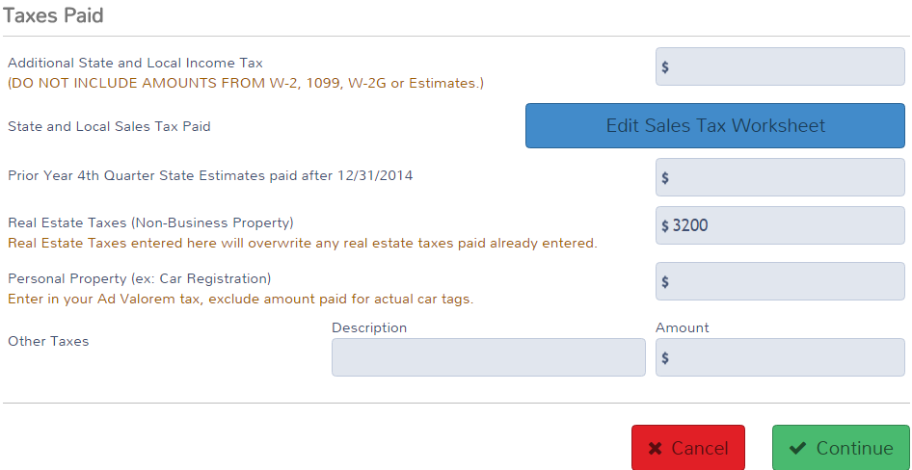
TS - Property Tax Rebates Claimed on Schedule A Line 6 Federal Section \ Deductions \ Enter Myself \ Itemized Deductions \ Taxes You Paid
Property taxes paid minus PTR/HB recoveries
Schedule A Line 6 # must still be positive and taxpayer must still be itemizing
Notes:
17

Slide 18
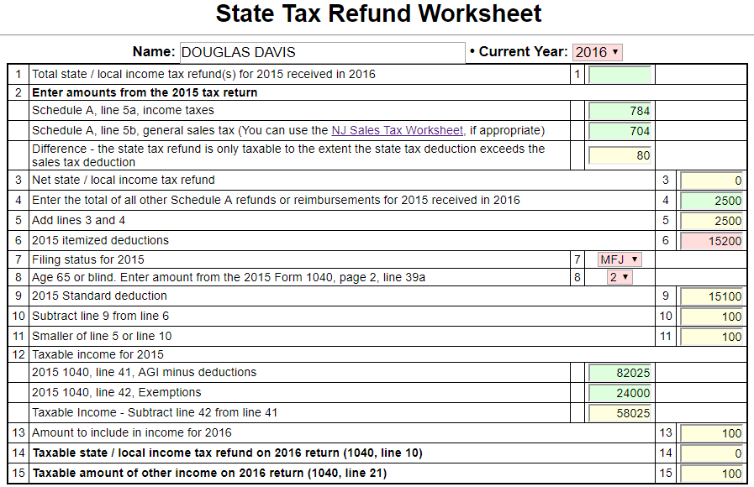
TS - Property Tax Reimbursement (PTR) Recovery Claimed on State Refund Worksheet Use Sales Tax Refund Worksheet on TaxPrep4Free.org to Determine Taxable Amount of PTR Recovery
If rebates can’t be netted on Sch A, enter PTR recovery in State Tax Refund worksheet
Enter other info from prior year’s return
Taxable amount of PTR recovery;
Enter in TaxSlayer as Other Income
If taxpayer received both an income tax refund and PTR recovery in current year,
enter both on State Tax Refund worksheet. Total taxable amount will be apportioned
between Taxable Refund on 1040 Line 10 and Other Income on Line 21
Notes:
18

Slide 19
TS – PTR Recovery Claimed on 1040 Line 21 Federal Section \ Income \ Enter Myself \ Other Inc. Not Reported Elsewhere
If rebates can’t be netted on Sch A, enter taxable amount of PTR recovery from State Tax Refund worksheet as Other Income in TaxSlayer
Notes:
19

Slide 20
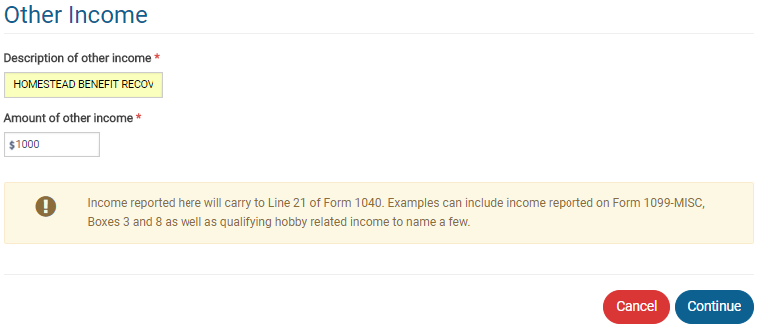
TS – Homestead Benefit (HB) Recovery Claimed on 1040 Line 21 Federal Section \ Income \ Enter Myself \ Other Inc. Not Reported Elsewhere
If rebates can’t be netted on Sch A, enter HB recovery as Other Income in TaxSlayer; use total HB recovery amount since you cannot use Sales Tax Refund worksheet for recovery 3 years old
Notes:
20

Slide 21
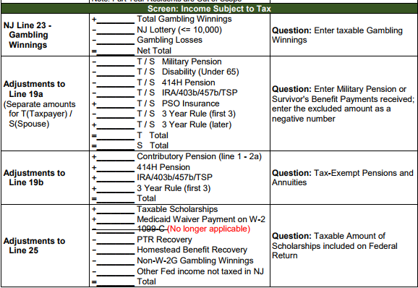
NJ Adjustment for Property Tax Recoveries on 1040 Line 21
(cont’d)
Property tax recoveries on 1040 Line 21 are not taxable in NJ
Need to exclude recovery amounts from NJ 1040 Line 25 Other Income
Capture recovery amounts in NJ Checklist Income Subject to Tax section for later entry in the TaxSlayer State section
Notes:
21

